Slide 1



Exploring Future Work Environments Analysis of User Acceptance for a Mixed-Reality Office Prototype
287623952
241464840
0
Virtual-Office
Lorenz Wackerle | 24.04.2021 | @RealEstateInnovates

Slide 2
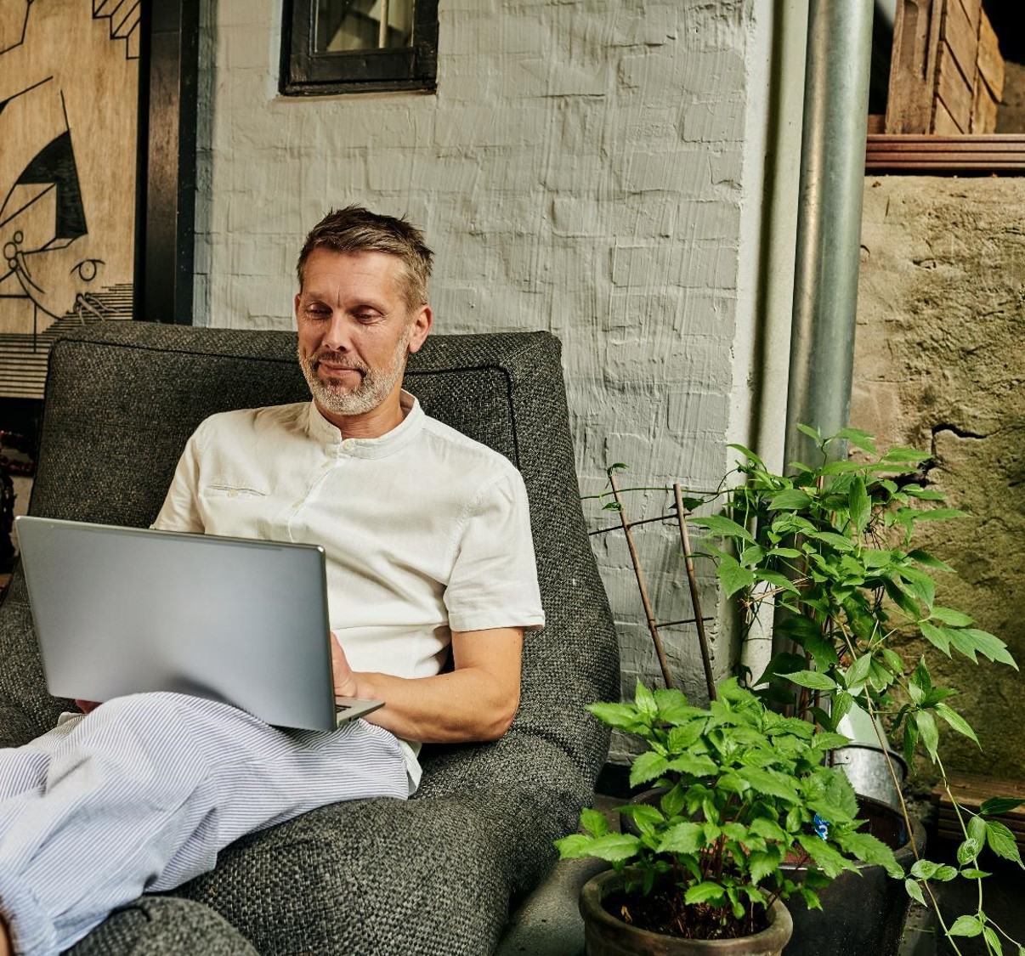
1. Introduction 1.1 Relevance of Research 1.2 Research Purpose and Question 1.3 Structure and Approach

Slide 3
1.1 Relevance of Research
All forecasts predict an increased amount of home office, post COVID-19. The advantages are clear; however, the disadvantages should be considered also.
What do you not miss from being in the office?
What do you miss from being in the office?
75% I miss direct contact to my colleagues when working remotely.
48% My work is impeded, whilst working remotely, due to difficulties communicating spontaneously with colleagues and managers.
55 % Commuting and wasted time.
18 % Noise, interruptions and distractions.
Source: Founders Forum und DAK, 2020
Notes:
x

Slide 4
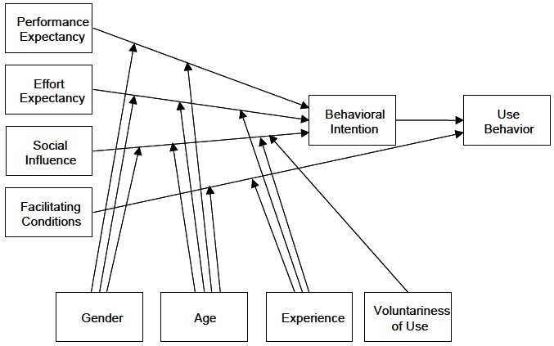
1.2 Research Purpose and Question
To evaluate the user-acceptanceand analyze the factors which affect this, so that the demand for a Virtual-Office rollout at Deutsche Telekom can be assessed
“Which factors affect the user acceptance of mixed-reality working environments?”
Field of research: „Computer Supported Cooperative Working” CSCW
Standard UTAUT Model (Venkatesh et al., 2003)
Notes:
Evaluate the User-Acceptance and Isolate the Factors which affect it.

Slide 5
1.3 Structure and Approach
2 Theoretical Foundations
2.1 Organisational Development
2.1.1 Classical
2.1.2 Neoclassical
2.1.3 Modern
2.2 Technological Development
2.2.1 Communication, media and data
2.2.2 Mixed-Reality
2.3 Changing Working Environment
3.4.1 Virtual Office UTAUT Model
3.4.2 Research Hypotheses
3.4.3 Variable Definitions
3.4.4 Model Design
4 Research Design
4.1 Data Collection
4.1.1 Questionnaire Survey
4.1.2 Questionnaire Design and Implementation
4.1.3 Reliability
4.1.4 Validity
4.1.5 Ethics
4.2 Data Analysis
3 Empirical Foundations
3.1 Mixed-Reality Office Prototype
3.1.1 Introduction Work Adventure
3.1.2 Implementation and Adaption to Use Case
3.2 Data Collection Methods
3.2.1 Quantitative
3.2.2 Qualitative
3.2.3 Appropriate
3.3 Technology Acceptance Theories and Models
3.3.1 Theory of Planned Behavior (TPB)
3.3.2 Theory of Reasoned Action (TRA)
3.3.3 Technology Acceptance Model (TAM)
3.3.4 The Unified Theory of Acceptance and Use of Technology (UTAUT)
3.3.5 Consumer Acceptance and Use of Technology (UTAUT 2)
3.4 Development of Model
5 Findings
5.1 Descriptive Analysis
5.2 Hypothesis Testing
5.3 Moderator Analysis
6 Discussion
6.1 Influences of Variables on each other
6.2 … [variables continues]
6.3 Recommendations
6.4 Limitations
7 Conclusion

Slide 6

References
DAK. (2020). DIGITALISIERUNG UND HOMEOFFICE IN DER CORONA-KRISE Ausgangslage und Fragestellung. https://www.presseportal.de/download/document/689784-20200721-gesundheits-ice-digi-corona.pdf
Venkatesh, V., Morris, M., Davis, G., & Davis, F. (2003). User Acceptance of Information Technology: Toward a Unified View. MIS Quarterly, 27, 425–478. https://doi.org/10.2307/30036540
Contact
„Trust develops between meetings“
Lorenz Wackerle
Lorenz.Wackerle@telekom.de

